Slide 1
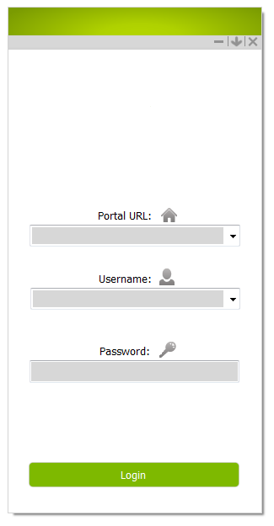
Login Window
1- Enter portal address of your organization.
(This address is unique for each organization)
2- Enter your user name here.
3- Enter your password here.
4- After entering above information click this button.
1
2
3
4

Slide 2
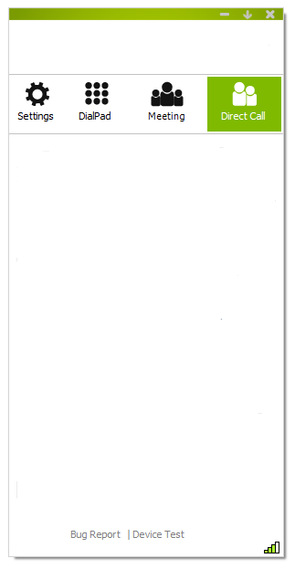
Public Components
1- Application will be closed by clicking here.
2- By clicking here, application will goes to tray icon. Then to restore application, you need to click on its tray icon at down-right corner of desktop.
3- Application will be minimized by clicking here.
4- Point to point call (only between two person)
5- Holding conference or joining in a conference (between multiple person)
6- specific calls (call by number, joining to an inter organization conference or call a legacy)
7- Software settings and configurations
8- Your connection quality with video conference data center will be shown by this antenna Icon.
9- Click here to check your devices (microphone, speaker and camera)
10- If any error happened in application, click here to send it through email to support center.
3
2
1
7
6
5
4
10
9
8

Slide 3
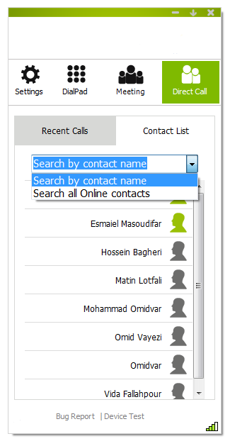
Contact List Tab
1- Finding person, who you want to call him (or her)
2- Recent events including all your sent/received calls and messages
3- By default, you can see your contact list here. But if you search someone, you can see the result here.
4- Searching people by their name, user name or their number
5- Searching all online people
6- Each row contains person name and icon. To call each person, click on his (or her) row. Person icon shows their current status (Such as offline, online, busy and etc)
2
1
3
4
5
6

Slide 4







User Status Icon
 | OFFLINE: The user is not logged in so you cannot place a direct call to them, but you can join their room, depending on its status.
 | Available: The user is available for a direct call, to join a room, or to be invited to attend a meeting.
 | Busy: The user is busy and you cannot contact them with a direct call or invite them to join your room.
 | In Room: The user is in their own room. You cannot call them directly but you can join their room.
 | In Room/Room Full: The user is in their own room and the room is full. You cannot call them directly or join their room.
 | In Room/Room Locked: The user is in their own room and the room is locked. You cannot call them directly or join their room. They can leave their room and join yours if they choose to.
 | In a PIN-protected Room: The user is in their own room and the room is PIN protected. You cannot call them directly, but you can join their room if you have their PIN code.
 | Legacy: The conferencing system uses legacy videoconferencing technology (such as H.323 and SIP). There is no personal room.

Slide 5
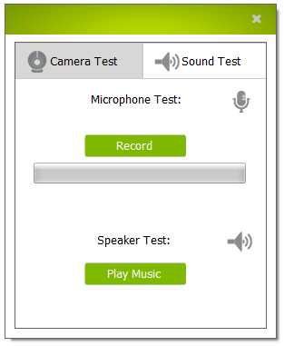
Audio Devices Test Window
1- Testing Audio Devices
2- To test microphone, click here to record your voice. Then start talking and after awhile, Click on this button again to hear your recorded voice and be sure about both microphone and speaker quality.
3- If your microphone is OK, This bar shows intensity of your voice.
4- If you want to test your speaker quality, click here to hear ring tone.
5- Close Window
5
1
2
3
4
If devices are not working here:
Check their hardware or installation.
If devices work well here but not during conference:
Go to Devices option in Settings tab to check if your device, has not been selected.

Slide 6
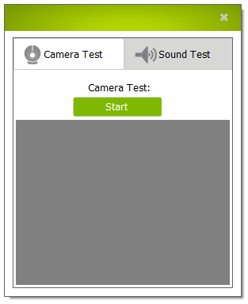
Video Devices Test Window
5
1- Testing Camera
2- By clicking this button, Windows shows camera video on the below area.
3- Camera Video Window
4- Testing Audio Devices
5- Close Window
4
1
2
3
If devices are not working here:
Check their hardware or installation.
If devices work well here but not during conference:
Go to Devices option in Settings tab to check if your device, has not been selected.

Slide 7
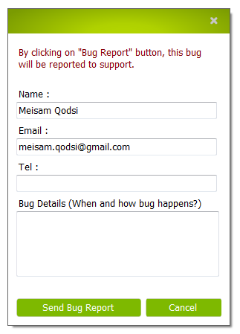
Bug Report Window
1- Your Name
2- Your Email Address. (If your email address has been stored already in your profile, it will be written here automatically)
3- Your telephone number
You must enter your email address and telephone number, so support center be able to contact you for solving the problem.
4- By clicking this button, all software activity details will be sent to support center automatically but if you have any description about how, when or form of happening error, you may write it here.
5- Click this button to send your report whenever you complete above information.
6- Cancellation of sending report.
7- Close this window.
7
1
2
3
4
5
6

Slide 8
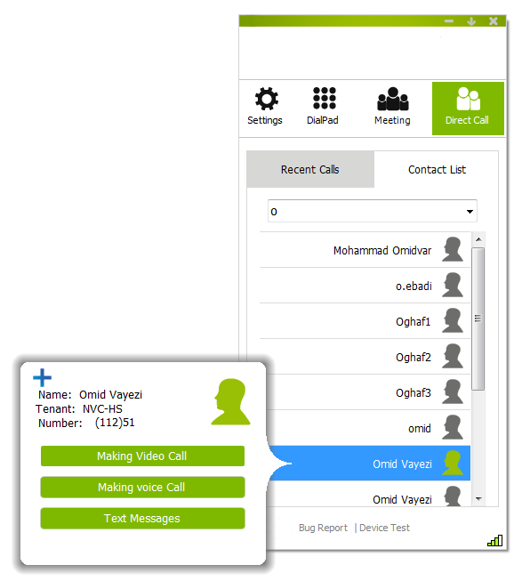
Direct Call Window
1- Person’s Current Status Icon (OFFLINE, ONLINE, BUSY, …)
2- Name and Family of this person
3- If this person is not in your contact list, you can add them to your contact list by clicking on this Icon, so you will not need to search them again to call them or invite them to your conferences. If this person is already in your contact list, you will see a X Icon here, which could delete them from your contact list.
4- Organization of this person
5- Calling number of this person, with below format:
“(Organization Number) Person Number”
You can search people by their number here or you can call them by this number using DialPad tab.
6- By clicking on this button, you can make a video call to this person.
7- By clicking on this button, you can make a voice call to this person.
8- By clicking on this button, you can send/receive text messages to this person.
3
2
1
4
5
6
7
8

Slide 9
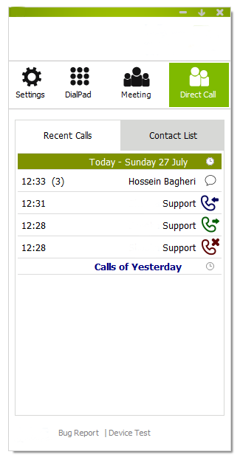
Recent Calls Tab
1- Calls Date
2- Received Message - To know about this person current situation (ONLINE, OFFLINE and etc ) click on their row.
3- Received Call - To know about this person current situation (ONLINE, OFFLINE and etc ) click on their row.
4- Sent Call - To know about this person current situation (ONLINE, OFFLINE and etc ) click on their row.
5- Missed call - To know about this person current situation (ONLINE, OFFLINE and etc ) click on their row.
6- To see Calls of Yesterday, recent week or month click here.
7- Time of Call
8- Number of Massages
1
2
3
4
5
6
7
8

Slide 10
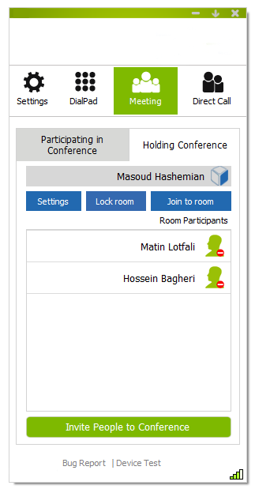
Holding Conference Tab
1- You want to Hold a conference in your own room.
2- You want to go to others room to join their conference.
3- Your conference room with an icon, which shows your room’s current status(Empty, Busy, Full, Lock and etc).
4- Click on this button to join your room.
5- If you click on this button, your room will be locked and other people no longer can join your room without your invitation. To unlock your room, click here again.
6- To perform advanced settings on your room (protect it by a pin or inviting guests) click on this button.
7- List of people who are in your room currently.
8- Each row contains a person’s name and their current status icon. To control them (Mute audio or stop video or remove them from conference) Click on their row.
9- To select your conference members and inviting them, click on this button.
2
1
5
3
6
4
8
7
9

Slide 11





Room Status Icon
 | Empty Room: No one is the room and you can enter.
 | Occupied Room: There are some people at room right now but you can enter it also.
 | Locked Room: Room owner locked it and you can not enter until the owner would invite you. You can ask him (or her) by sending a text message through Contact List (in Direct Call Tab). (If you already activate this option on your software)
 | Full Room: The Room is full and no one can enter it until someone came out of it.
 | Pin Protected Room: You need room pin code to enter it.

Slide 12
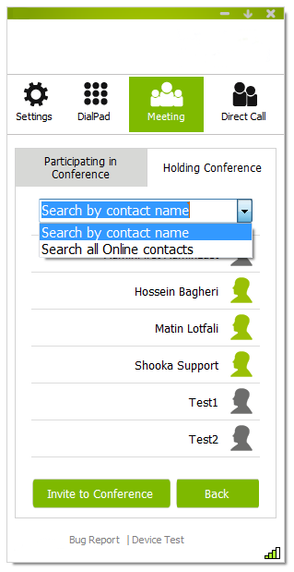
Invite People To Conference Slide window
1- To invite each online person, click on their row. You could select all your conference members and then click on “Invite to conference” button one time to invite all of them.
2- After selecting your conference members, click on this button to invite them. An invitation window will appears on their screen and they can join your conference by accepting your request.
3- After inviting people, click on this button to return to your conference window and see your conference participants.
You can also invite legacies to your conference,
but since they are not searchable, you should
enter their code in search bar and then click
on “Invite to Conference” Button.
1
2
3

Slide 13
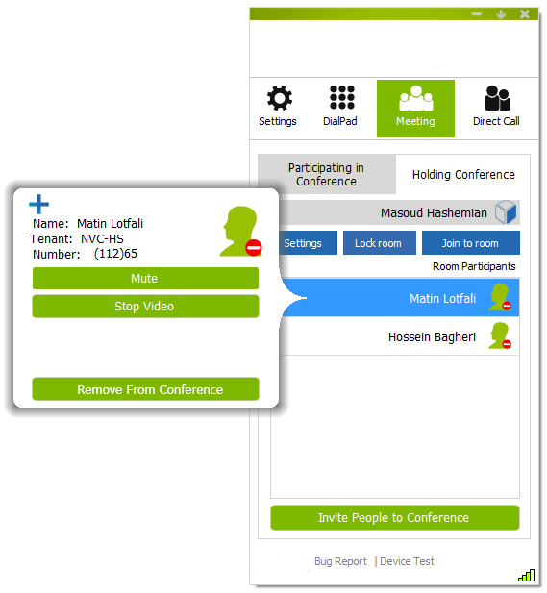
Conference Participants Control Window
1- Click on this button to mute participant’s audio.
(To unmute this person, click on this button again)
2- Click on this button to stop participant’s video.
(To unmute this person, click on this button again)
3- Click on this button to remove participant from conference.
1
2
3

Slide 14
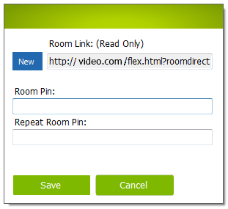
Room Settings Window
1- Your room’s Internet link for inviting guests: To invite guests (people without UserName) you just need to email this link to them and they should enter it in their browser to join your room without any UserName. (To use this option, you need to activate it already)
2- Your room’s Internet link would be stable and your later conference guests would be able to join your room at future by the same link, unless you click on this button to change it.
3- If you want to allow certain people to join your room, set a Pine code for your room in this text box and send this Pin code for them.
4- Retype Pin code to be sure of its correction.
5- Click on this button to save new Pin code.
6- Click on this button to close this window.
2
1
3
4
5
6

Slide 15
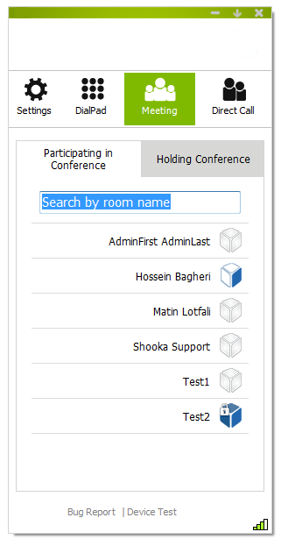
Participating In Conference Tab
1- By default, you can see your contact list rooms here, but if you search a room name, you can see the result here.
2- Searching rooms by their name
3- Each row contains room name and icon. To enter each room, click on its row. Room icon shows their current status (Such as empty, occupied, locked and etc)
1
2
3

Slide 16
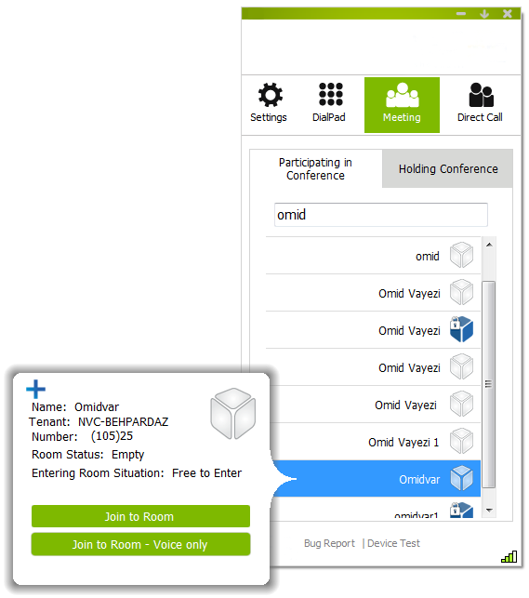
Joining Room Window
1- Room Status Icon (Empty, Occupied, Lock and etc)
2- Room Name
3- If this room owner is not in your contact list, you can add them to your contact list by clicking on this Icon, so you will not need to search them again to call them or invite them to your conferences. If this person is already in your contact list, you will see a X Icon here, which could delete them from your contact list.
4- Organization of this room
5- Calling number of this person, with below format:
“(Organization Number) Person Number”
You can search people by their number here or you can call them by this number using DialPad tab.
6- Current status of the room (Empty, Occupied or Full)
7- Entering condition (Free to enter, Locked, Pin Protected)
8- Click on this button to enter the room
9- Click on this button to enter the room
(Voice Only)
3
2
1
4
5
6
7
8
9

Slide 17
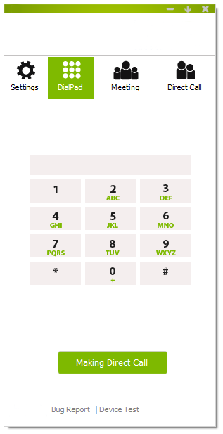
Dial Pad Tab
1- Enter your calling number by keyboard here.
2- You can use this dial pad to enter your calling number by mouse.
3- Click on this button after entering calling number.
Call a person by number:
Enter person’s number with (or without) organization number. For example for a person with (112)36, you can call 36 or 11236.
Inter Portal Communication (IPC):
Enter user name and their organization portal in the form of “UserName@Portal” to enter their room. For example m.hashemian@vr1.video.com
Calling Legacy:
To make a direct call with a legacy, you need to enter their code and then click on below button. Since legacy addresses are different based on their model and architecture, ask support center for more information.
1
2
3

Slide 18
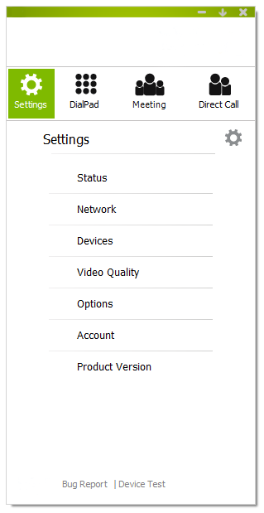
Settings Tab
1- During conference, by clicking on this option, you can see your video router’s name and Audio/Video quality details for each conference participant.
2- Network configuration including ports range and proxy settings.
3- Selecting camera, Microphone and speaker and audio level adjustments
4- Changing video quality details for you conference participants
5- Other options such as Language, start software at windows startup, auto answer option, show participant’s name and conference time.
6- change password
7- Software version and check for update
1
2
3
4
5
6
7

Slide 19
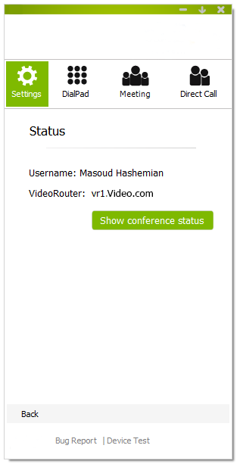
Settings Tab – Status
1- Your name and family
2- During conference, your video router’s address will be written here.
3- During conference, this button will be enable. By clicking on it, you can see Video/Audio quality details for each participant and network traffic.
1
2
3

Slide 20
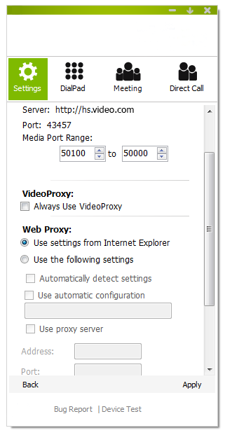
Settings Tab – Network
1- Your organization portal
2- Application communication port
3- UDP port range to transmit Audio/Video
4- Click here if you want to use video proxy
5- If your organization has proxy, simplest way to connect to portal through proxy is to choose this option. Then application automatically extract proxy settings from your Internet Explorer browser.
6- setting all Proxy Configuration details by your own
7- Save changes, apply them and return to settings tab.
8- Ignore changes and back to Settings Tab
1
2
3
4
5
6
8
7

Slide 21
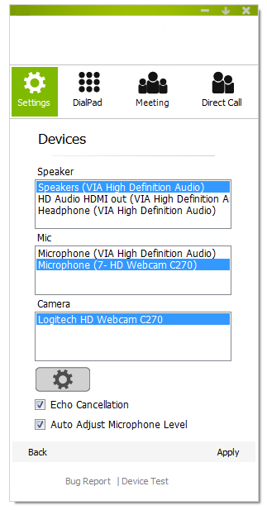
Settings Tab - Devices
1- Select one of the system speakers to be used for future conferences.
2- Select one of the attached microphones to be used for future conference.
3- Select one of the detected cameras to be used for future conference.
4- After entering conference, to adjust camera (light level and etc)
5- Click here to reduce your voice echo.
6- Click here to adjust your microphone at its best level (with minimum echo).
After selecting your devices, go to “Device Test” link to be sure if they work correctly.
1
2
3
4
5
6

Slide 22
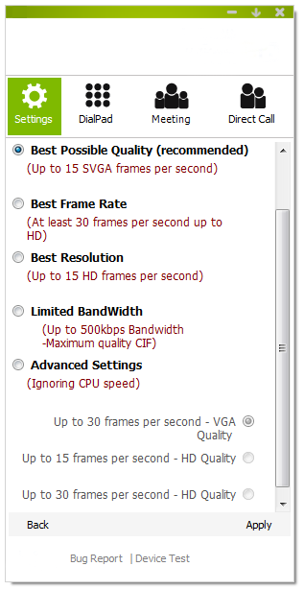
Settings Tab – Video Quality
1- Default - All resolutions above SVGA are filtered out. For VGA resolutions and above (including SVGA), frame-rate is limited to 15 FPS.
2- All resolutions above 720p are filtered out. Minimal frame-rate is 30 FPS.
3- All resolutions above 720p are filtered out. Maximal frame-rate is 15 FPS.
4- Limit the maximum encoding resolution to CIF. No limit on the frame-rate – would initially be 30 FPS. Set the initial ABA available receive bandwidth for video to 500Kbp/s.
5- Ignoring CPU speed options
6- Limit resolution to 450p. (VGA)
7- Limit resolution to HD. Limit frame-rate to 15 FPS.
8- Limit resolution to HD.
CIF images has 352*288 pixel
VGA images has 640*480 pixel
SVGA images has 800*600 pixel
HD images has 1280*720 pixel
1
2
3
4
5
6
7
8

Slide 23
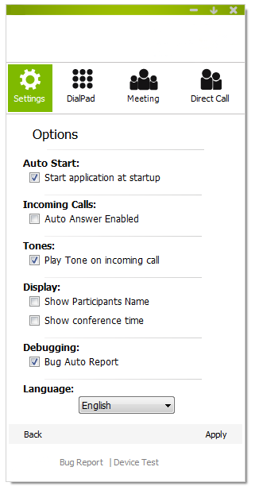
Settings Tab - Options
1- Click here to start application whenever windows starts.
2- Activate auto answer for incoming calls
3- Play software tone for incoming calls
4- Show participants Name below their video during conference
5- Show conference time at top-right corner of conference window
6- By clicking this option, whenever software encounter an internal error (or in crash situations), it ask you to send the report for support center to help software team to solve your problem.
7- You can change software language here.
1
2
3
4
5
6
7

Slide 24
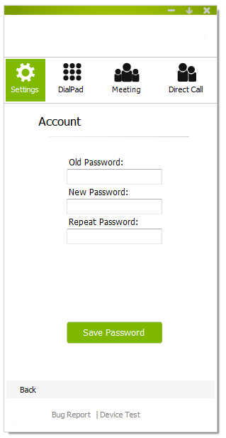
Settings Tab - Account
1- To change your current password, type your old password here.
2- Enter your new password here.
3- Repeat your new password here.
4- After entering above information, click on this button.
If you forget your password,
You should ask support center to reset it.
1
2
3
4

Slide 25
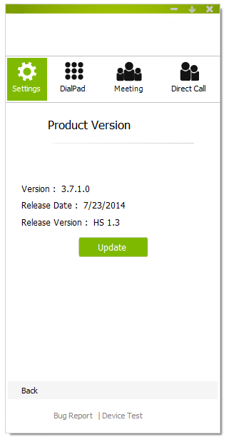
Settings Tab – Product Version
1- Software version
2- Release date of this version
3- Your service details
4- Manual update button – When the software starts, it checks for update automatically. But if you don’t have enough time (or bandwidth) to download its update, you can always ask for manual update by clicking on this button.
In each update, you just receive changed files, which usually are about 500 KB.
1
2
3
4

Slide 26
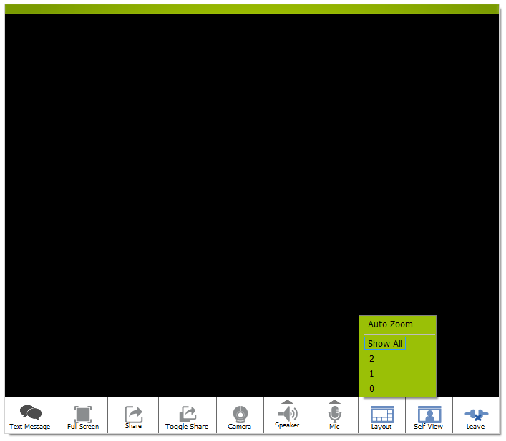
Conference Window
1- Click here to send/read conference participants text messages.
2- Click here to start/stop full screen mode.
3- Click here to share a program window (or desktop) with other participants.
4- If some participants shared their documents, click here to select which document you want to see?
5- Click here to stop/start your camera video for participants.
6- Click on speaker to mute/unmute your speaker. Click on small triangle to change its level.
7- Click on microphone to mute/unmute your microphone. Click on small triangle to change your voice level.
8- Click here to limit number of videos on your screen (Low internet speed) “Show All” shows up to 8 concurrent video. “Auto Zoom” will zoom video of participant who talks louder.
9- Click here to control how to show your self view (In hide, small and big modes)
10- Click here to leave the conference.
1
2
3
4
5
6
7
8
9
10

Slide 27
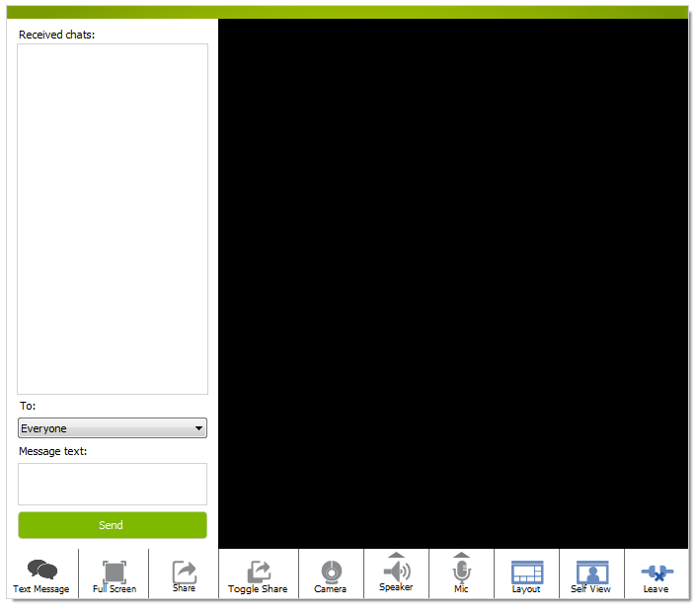
Conference Chat Window
1- your sent/received messages
2- If you want to send a message, first select your destination. Default destination is “Everyone” which means all conference participants will see your message.
3- Enter your message here.
4- Click on this button (or press enter) to send your message.
5- After sending/reading your messages, click here to close chat window.
1
2
3
4
5

